Slide 1
Personalized Planning & Advice
Re-engagement Campaign

Slide 2
Agenda
Campaign Overview
Email Samples
Destination Pages

Slide 3
Campaign Overview

Slide 4
Campaign Overview
Our goal
Re-engage participants that started their Personal Profile or generated a Proposal to return and learn more or complete their enrollment
Objective
To re-engage participants who’ve indicated interest in exploring PP&A as an investment solution
Reinforce the value that PP&A provides in creating an investment strategy based on the participant’s unique financial situation
Reassure participants that we are here to help answer any questions they may have or help them complete the enrollment process
Audience
PP&A eligible participants (Segs 3-5 only) who have either:
Abandoned the Quick Path experience, or started but didn’t complete their Personal Profile, or generated a Proposal but didn’t accept it
Campaign structure
    Responsive trigger
    2 emails sent to each participant, unless participant enrolls or makes an asset allocation change
    First email sent on the next scheduled send day (Monday, Wednesday, or Friday) after abandonment
    Second email sent a week after the initial touch if no action was taken

Slide 5
Email Samples

Slide 6
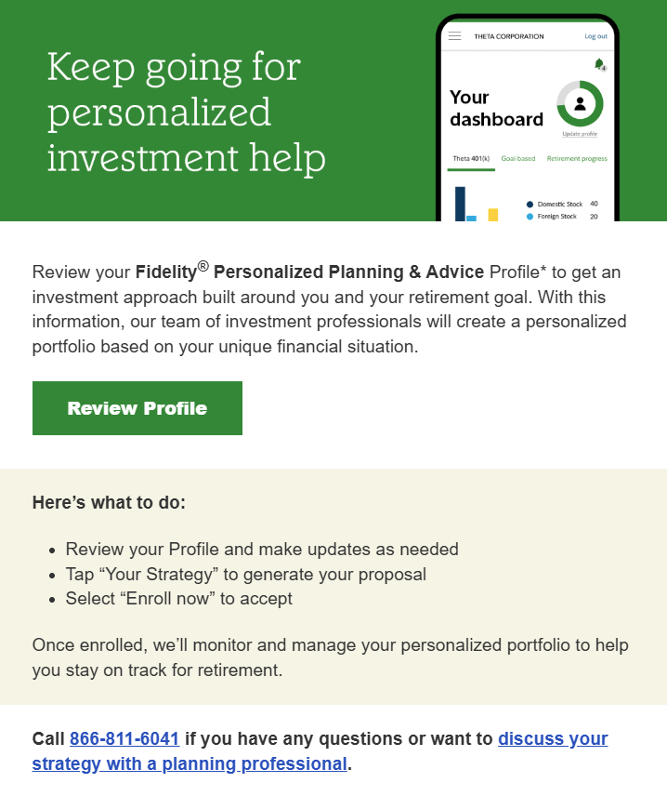
Touch 1A
Review Personal Profile
Sent on the next scheduled send day (Monday, Wednesday, or Friday) after the participant abandons the Personal Profile
Drives to the first tab of the Personal Profile
Also includes Workplace planning phone number and the digital appointment scheduler

Slide 7
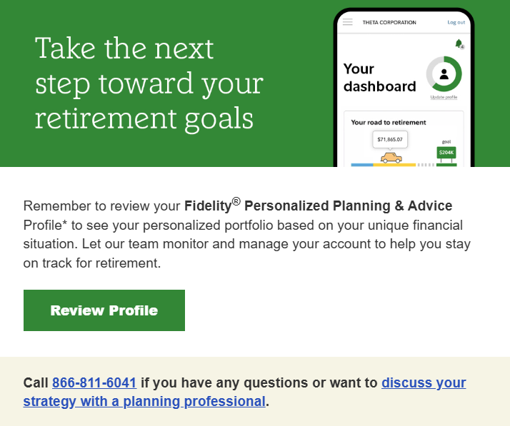
Touch 1B
Reminder to review Personal Profile
Sent a week after the initial touch if no action was taken
Drives to the first tab of the Personal Profile
Also includes Workplace planning phone number and the digital appointment scheduler

Slide 8
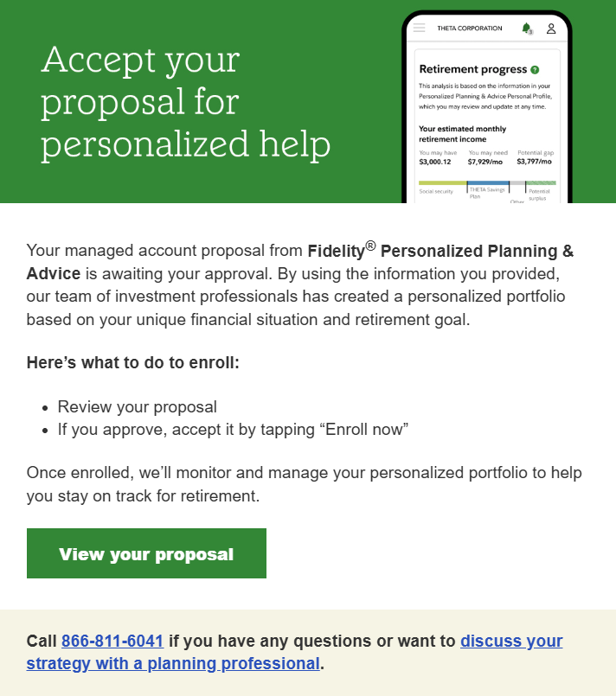
Touch 2A
View & Accept Proposal
Sent on the next scheduled send day (Monday, Wednesday, or Friday) after the participant abandons their Proposal
Drives to the last tab of the Personal Profile
Also includes Workplace planning phone number and the digital appointment scheduler

Slide 9
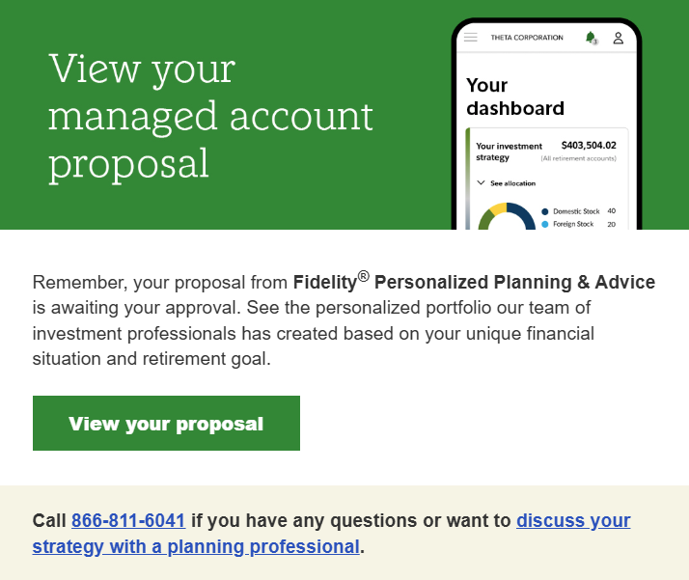
Touch 2B
Reminder to view & accept Proposal
Sent a week after the initial touch if no action was taken
Drives to the last tab of the Personal Profile
Also includes Workplace planning phone number and the digital appointment scheduler

Slide 10
Destination Pages

Slide 11
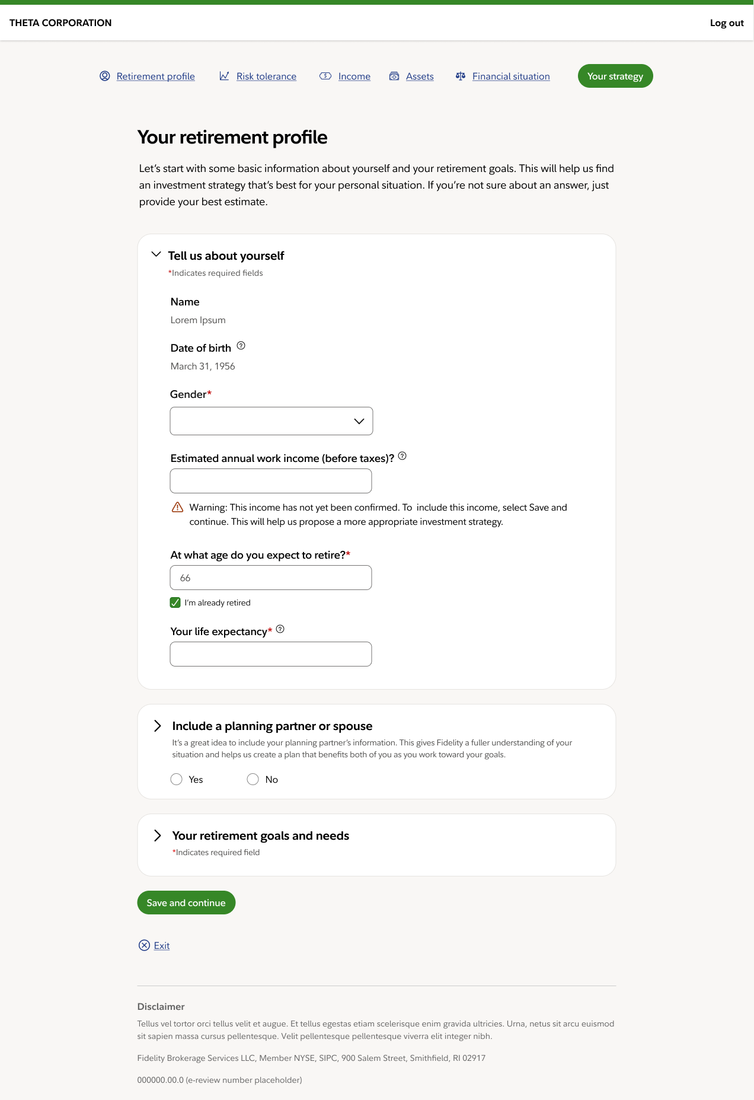
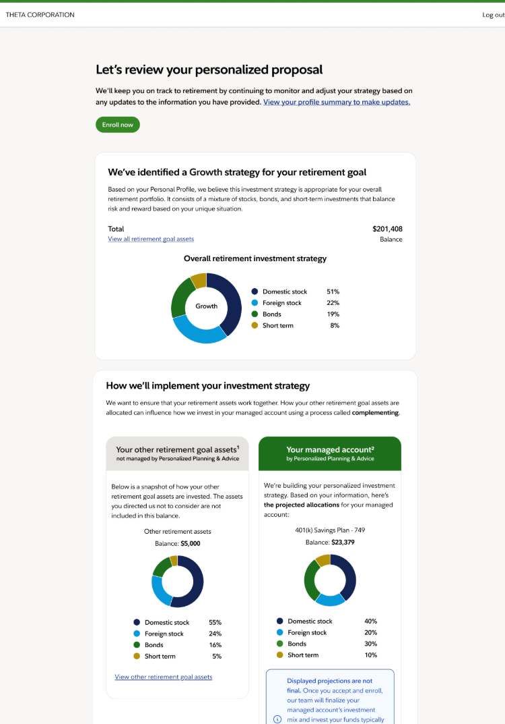
Destination Pages
Personal Profile
Proposal Page

Slide 12
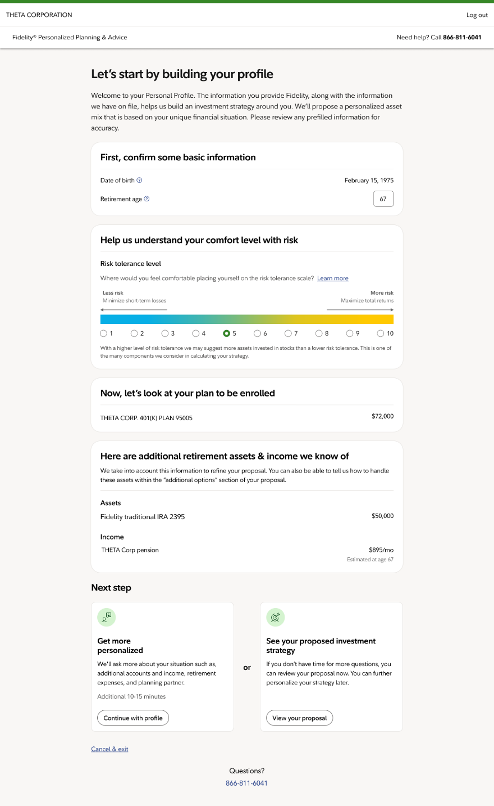
Destination Pages
Quick Path

Slide 13
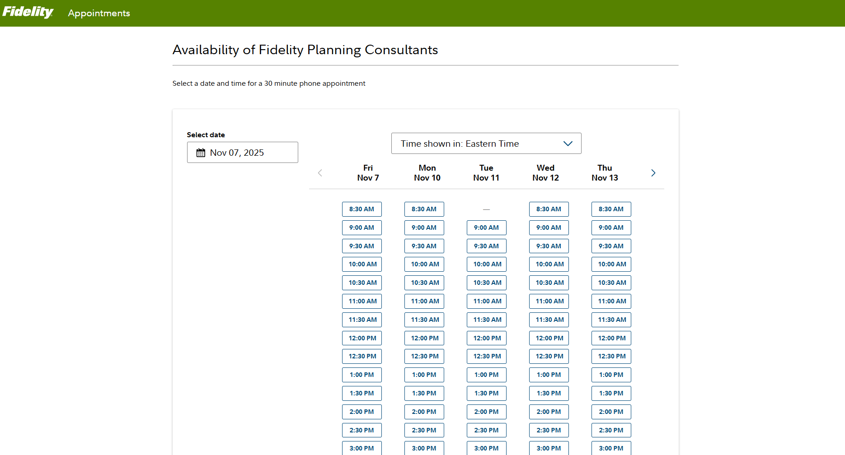
Destination Pages
Digital Appointment Scheduler

Slide 14
Important information
Screenshots are for illustrative purposes only.
For institutional and plan sponsor or investment professional use only.
Investing involves risk, including risk of loss.
Fidelity® Personalized Planning & Advice at Work is a service of Strategic Advisers LLC, a registered investment adviser and a Fidelity Investments company, and may be referred to as "Fidelity," "we," or "our" within. For more information, refer to the Terms and Conditions of the Program. When used herein, Fidelity Personalized Planning & Advice refers exclusively to Fidelity Personalized Planning & Advice at Work. This service provides advisory services for a fee.
Fidelity Brokerage Services LLC, Member NYSE, SIPC, 900 Salem Street, Smithfield, RI 02917
© 2026 FMR LLC. All rights reserved.
1247828.1.0

